Slide 1

Decision Making Strategies for Assistive AI AI Foundations for Practitioners – Week 7
Hưng Ngô
Founding director, Center of Talent in AI (CÓTÀI)
Previously: Chief of AI at AINovation
Researcher & lecturer, Swiss IDSIA
FB.com/curiousAI
Developed by

Slide 2
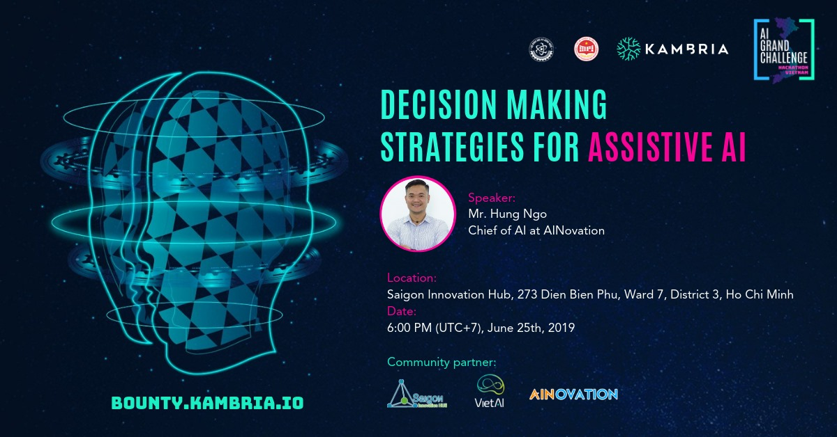
Outline
Contextual Bandits
Planning in (PO)MDP
Interactive learning for sequential decision making
(Introductory tutorial for Virtual Assistant Competition)
Notes:
ML takes a different approach. By applying concepts from a range of fields, including statistics, probability theory, and so on, we can build an ML system that “learns” to recognize handwritten digits by being trained on thousands, or even millions, of examples.
So, in order to get an accurate digit classifier, all we need to do is acquire lots of training examples, with labels (this is called “labeled training data”), and then feed it into the ML system.

Slide 3

Motivating example: Which advice?
Repeatedly:
Observe features of user+advice
Choose an advice.
Observe steps walked
Goal: Healthy behaviors

Slide 4
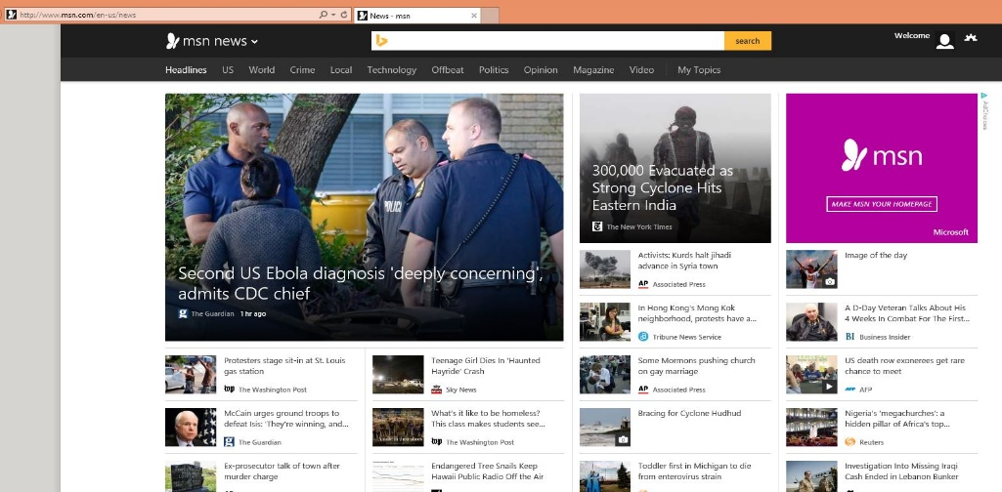
How about news?
Repeatedly:
Observe features of user+articles
Choose a news article.
Observe click-or-not
Goal: Maximize fraction of clicks
Notes:
Add Wellness

Slide 5
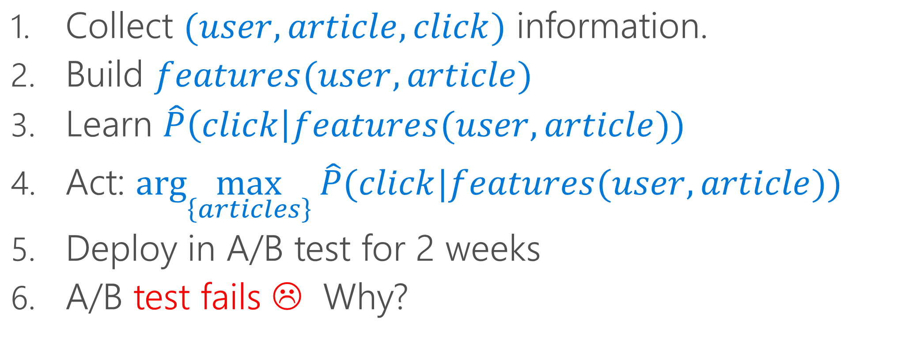
A standard pipeline
Collect $(user, article, click)$ information.
Build $features(user,article)$
Learn $\hat{P}\left(click\right|features(user,article))$
Act: $arg\max_{\left\{articles\right\}} \hat{P}(click|features(user,article))$
Deploy in A/B test for 2 weeks
A/B test fails ☹ Why?

Slide 6
Q: What goes wrong?
Model value over time
A: The world changes!

Slide 7
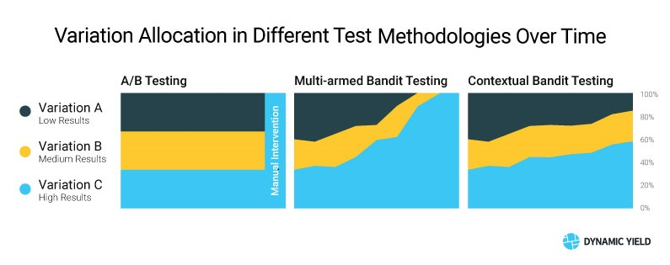

Slide 8

Interactive Learning
Action
(selected news story)
Learning
Features
(user history, news stories)
Consequence
(click-or-not)

Slide 9
Q: Why Interactive Learning?
A: $$$
Use free interaction data
rather than expensive labels
Example: Google Search Engine

Slide 10

Q: Why Interactive Learning?
AI: A function programmed with data
AI: A function programmed with data
AI: An economically viable digital agent that explores, learns, and acts

Slide 11
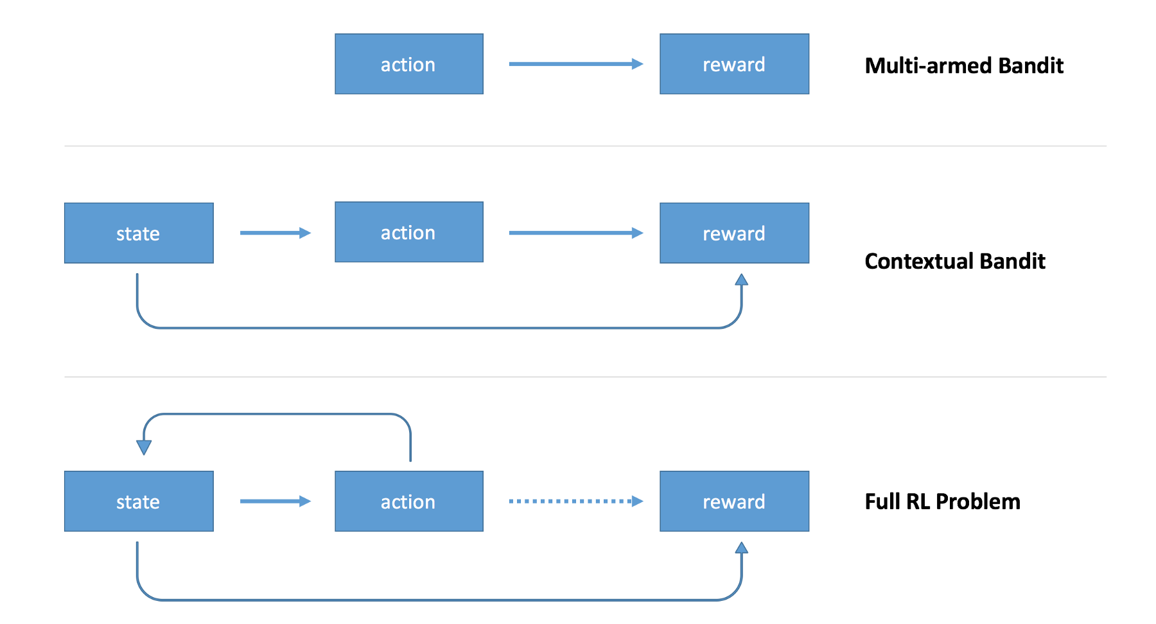
Flavors of Interactive Learning
RL: next state = f(history or current state, action), and sparse+delayed rewards
RL algs: mainly focus on learning to predict and control (credit assignment)
Bandits: mainly focus on exploration-exploitation tradeoff
context
Notes:
Revisit after motivations

Slide 12
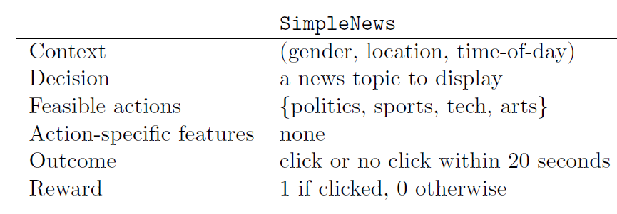
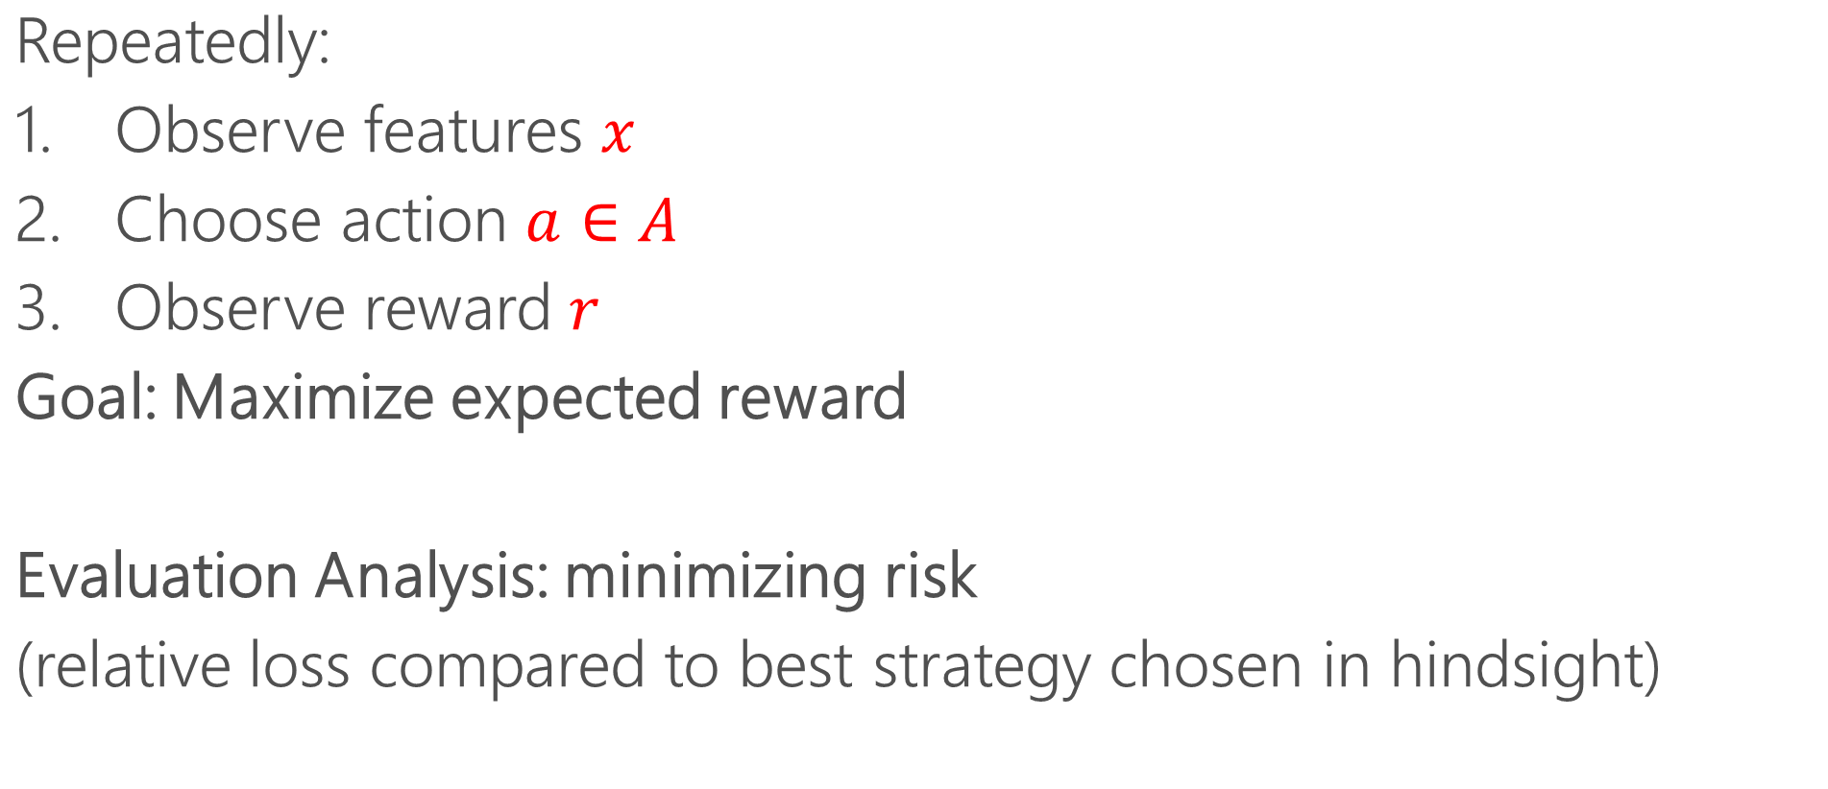
Contextual Bandits
Repeatedly:
Observe features $x$
Choose action $a∈A$
Observe reward $r$
Goal: Maximize expected reward
Evaluation Analysis: minimizing risk
(relative loss compared to best strategy chosen in hindsight)

Slide 13
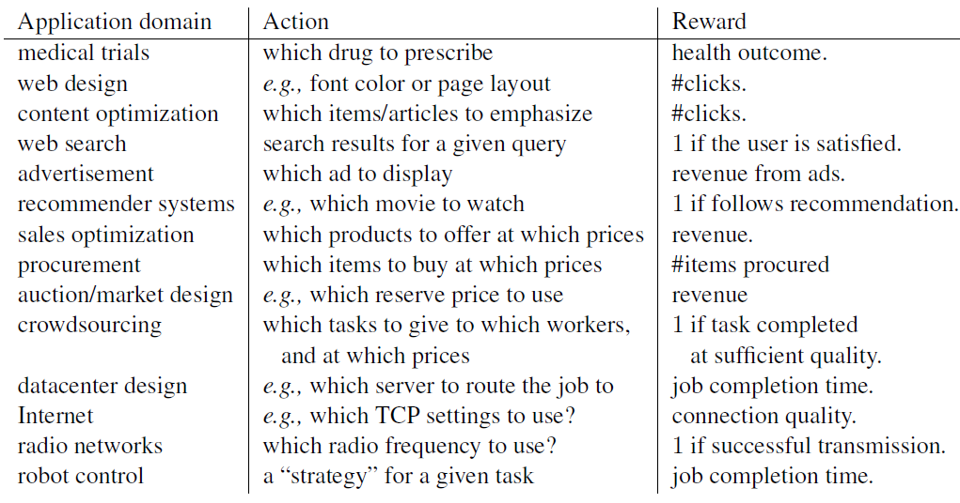
More Examples

Slide 14
More Examples
finance (portfolio choice, credit scoring, e.g., Profitable Bandits http://proceedings.mlr.press/v95/achab18a/achab18a.pdf)
retail (dynamic pricing, cross/up sale)
smart-homes (which services to activate)
influencers selection
dialog systems & virtual assistant (response selection)
security (anomaly detection)
planning (MCTS in games, warehouse, logistics)

Slide 15
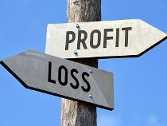

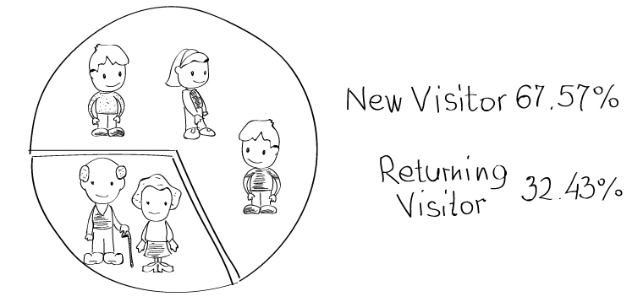
Reward signals
CB reward associated with a given (context, action)
Short-term proxies for long-term rewards
Clicks or dwell-time for user satisfaction
Exercise minutes in a day for weight-loss
Long-term reward predictor can be good short-term proxy
Quarterly profits
Weight loss
Number of returning users

Slide 16


Policies
Policy maps features to actions.
a_{t} = π₁(x₁, a₁, r₁,…, x_{t-1}, a_{t-1}, r_{t-1}, x_{t}) = π_{t}(x_{t})
E.g.: linear, greedy policy a_{t} = argmax_{a} $f_{t}^{a}$(x_{t}) with $f_{t}^{a}$(x_{t}) =$x_{t}^{T}w_{t}^{a}$
Policy = Classifier that acts

Slide 17

Exploration
Policy
Sports news
a_{t} = π_{t}(f_{t}(x_{t}))
f_{t} ⬄ knowledge distilled: good predictor exploit
But what if there are better functions than f_{t} ? explore

Slide 18
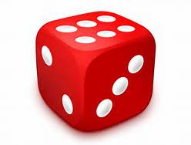
Exploration
Randomization
Policy
Sports news

Slide 19
Exploration
Randomization
Policy
AI tech news

Slide 20
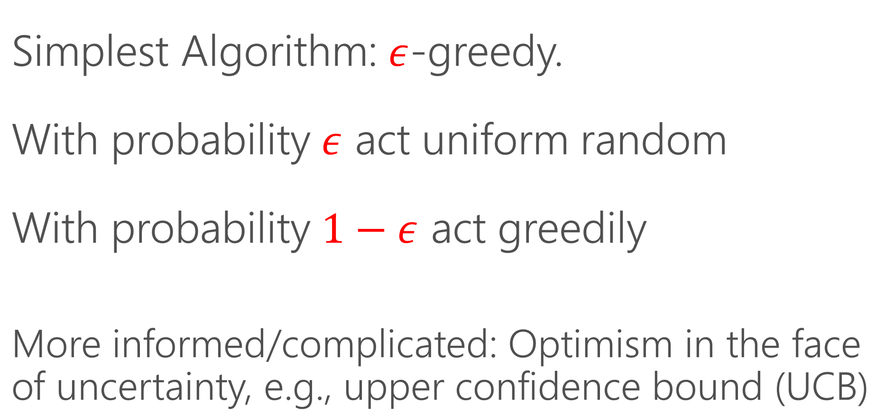
How do you do Exploration?
Simplest Algorithm: $ε$-greedy.
With probability $ε$ act uniform random
With probability $1−ε$ act greedily
More informed/complicated: Optimism in the face of uncertainty, e.g., upper confidence bound (UCB)

Slide 21
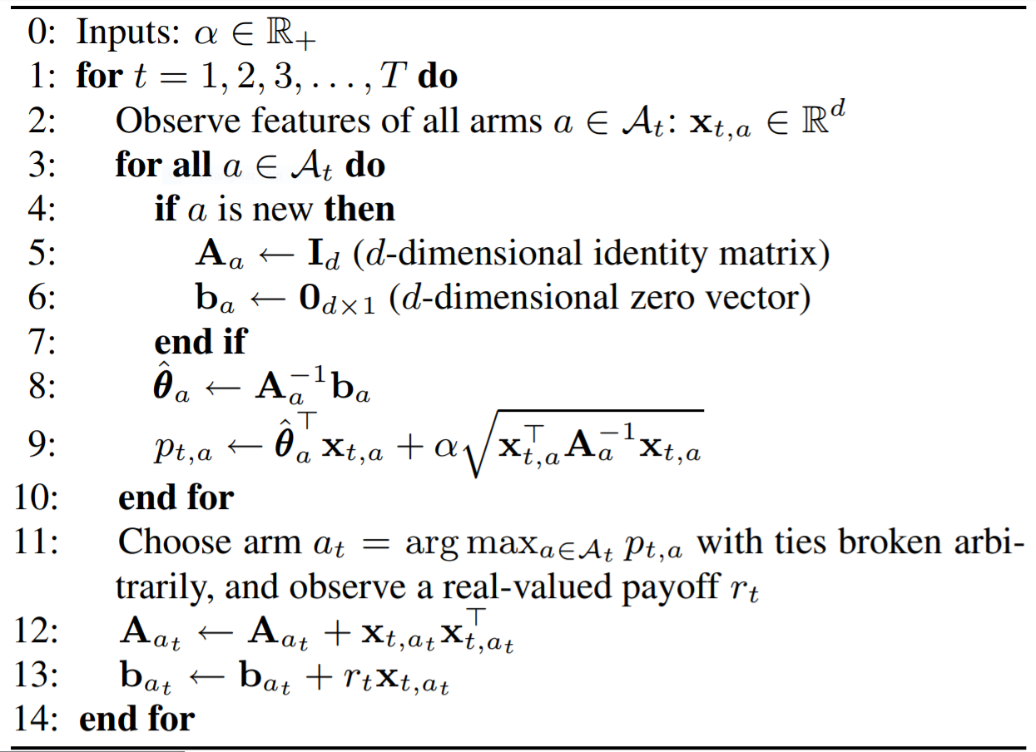
Example: LinUCB Algorithm
http://rob.schapire.net/papers/www10.pdf

Slide 22
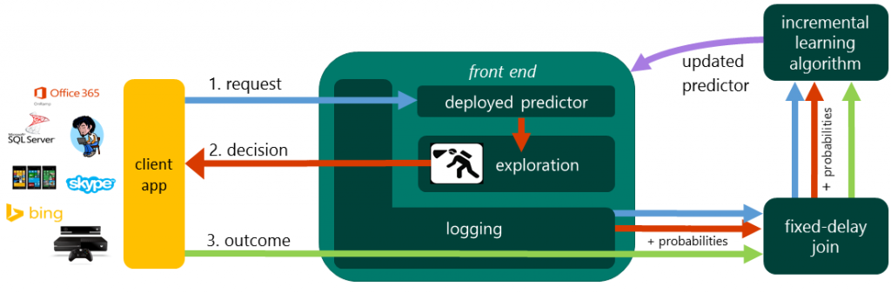
System Deployment
Microsoft Multiworld Testing (MWT)

Slide 23
Resources
http://hunch.net/~rwil/ (many of these slides are taken from here ☺)
https://github.com/aikorea/awesome-rl
https://paperswithcode.com/task/chatbot
https://paperswithcode.com/task/dialogue
https://github.com/topics/contextual-bandits
https://github.com/huazhengwang/BanditLib
https://paperswithcode.com/task/decision-making
https://github.com/brianspiering/awesome-deep-rl
https://github.com/topics/markov-decision-processes
https://paperswithcode.com/task/multi-armed-bandits
https://github.com/thiagopbueno/awesome-probabilistic-planning
http://people.idsia.ch/~ngo/ucwl2013/hridemo.html

